Slide 1



Company Profile
www.strategicservices.com

Slide 2
Who we are
Areas of expertise – IT&ITES Solutions
Strategic Outsourcing Services provides end-to-end business services to ensure robust, flexible and highly efficient IT environment to clients. Our specialty teams work meticulously with the clients to deliver client-specific software solutions across all technology platforms. With proficiency across the IT gamut, we aid our clients in every facet of business. Till date, we have helped many commercial businesses and government organizations to streamline and simplify IT processes through many services including:
System Integration
Application Development
Website Development
Product Development
Staffing Solution
Software Maintenance
HRMS
Cloud Computing
Mobile Applications

Slide 3
Who we are
Areas of expertise – IT&ITES Solutions
Our focus is to provide world class business Solutions using state‐of‐the‐art technology. We see each project as a building block in a long‐term business relationship with our clients. We provide high quality digital Solutions that empower our clients. Some of the markets our professionals have addressed include:
E‐Commerce
Retail
Insurance
Wholesale Distribution
Manufacturing
Health care
Shipping and Transportation
Financial Services
Social Media Integrations

Slide 4

Service Offerings
Application Development & Integration
Application Support and Maintenance
Migration, Extraction & Porting
Integration Management
Reports Development
Application Engineering
Responsive Web designs
Knowledge Blogs, Wikis
Document Management
Portal Development
Pull Data from ERP using Web services
Rich Web based front-ends
Cloud Development
Cloud Integration
Cloud Migration
Cloud Testing
Cloud Computing
Content Management Services
Mobile Computing
Testing Services
Manual Testing
Automation Testing
Performance Testing
Mobile App Development and Maintenance
Mobility Consulting and Advisory Services
Enterprise Mobility
Mobile Website & Custom Applications
Mobile Integration & Porting Services
Mobile Application Testing

Slide 5
Application Engineering
Application development & integration
Application support & maintenance
Migration & Porting
E-Commerce and web development
Legacy integration & web-enablement
Application Transition
Services
Distributed & Heterogeneous Architectures
E-Commerce and Web Development
EAI & Systems integration, rich internet applications
Report Development
Development models: Waterfall, Prototyping, Spiral, RAD, Iterative, RUP, SCRUM
24x7 support based on ITIL framework
Robust processes & methodologies
Mature transition framework
Multi-tiered governance and reporting
Tool based approach
Strict adherence to committed SLAs
Capabilities

Slide 6
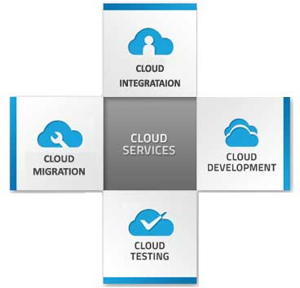
Cloud Computing (SAAS)
Cloud Platforms & Technologies
J2EE, JAVA, JSP, JSF, Jboss, HTML 5
Microsoft. Net , jQuery, Apache, Tomcat, Weblogic, AJAX

Slide 7










Mobile Computing
Mobile App Development and Maintenance
Mobile Application Testing
Mobility Consulting and Advisory Services
Mobility Solution
Apps Migration and Porting
Enterprise Mobility
Mobile Integration Services
Mobile Website & Custom Applications

Slide 8
Testing Services
Testing
Web Application Testing
Package Software Testing
Mobile Testing
Client Server Testing
Cloud Testing
Application Type
Functional Testing
Integration Testing
Performance Testing
Migration Testing
Security Testing
Internationalization & Localization Testing
Usability Testing
Managed Services
Testing Modes
Manual Testing
Automated Testing

Slide 9
Content Management Services
Enterprise Portal template, Site Directory, Content aggregation
Wordpress, Joomla, Drupal
PHP applications
Responsive Web designs
Rich Web based front-ends
LOB actions, pluggable
Enterprise single sign-on
Sites
Composites
Communities
Collaboration
Knowledge Blogs, Wikis
Special Interest groups
Reporting,
Dashboards,
Reporting Portals
Insights
Content
Search
Document Management
Enterprise Search, Security
Versioning, Data Archiving
IRM integration, Compliance
Enterprise Search (SAP, Oracle)
Pull Data from ERP using Web services
MOSS as a gateway for Other apps
(SAP, Oracle, Lotus & LOBs)

Slide 10

Our Skill Sets
Programming Languages & Web Development Tools
Microsoft .NET Framework, ASP.NET, C#.NET, VB.NET & ADO.NET
Java, J2EE, PHP
JSF, EJB,Hybernate, Struts
Visual C#.NET
Microsoft Visual Basic
Java Script, VB Script
HTML 5, DHTML, XML, PHP,CSS3
ASP, JSP, PHP & Java Servlets
J Query, Web services
Technologies
Windows .NET
Servlets,Spring MVC
Win32 API
XML/XSL, XML Schema, XSD, XHTML, XPATH, SOAP, XML RPC, WSDL, UDDI
Ajax
Database/RDBMS
MS SQL Server
My SQL, Oracle
Project Management
Smart Sheet

Slide 11
Our Skill Sets
Operating Systems / Platforms
Microsoft Windows XP / 2000
Microsoft Windows 2003 Server
Linux, Ubuntu
Application/Webservers
Microsoft IIS 5.0 / 6.0
Apache HTTP server
JBoss
Testing
QTP
Jmeter
Bug tracker
Burp, SOUP UI
Design
Adobe Photoshop
Dream viewer
Word press
Corel Draw
Illustrator

Slide 12


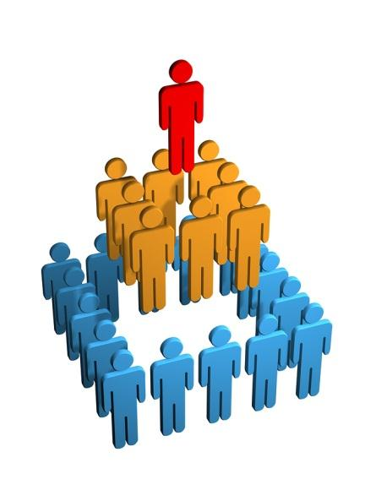
Our Team Structure
Project Managers
Content Specialists
Mobile Developers
UI Designers
Database
Architects
Solution Architect
Developers
Quality Assurance
Business Client Coordinators

Slide 13
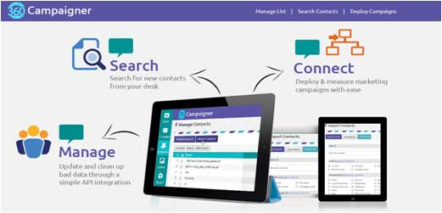
Client: 360 campaigner
Project Overview
A single platform to create and manage your campaigns
Fast and easy web-based access
Easy customization options
Entire process automated
Integrated Marketing Intelligence
Project Duration
1.6 year
Project Completed Date
May 2013

Slide 14
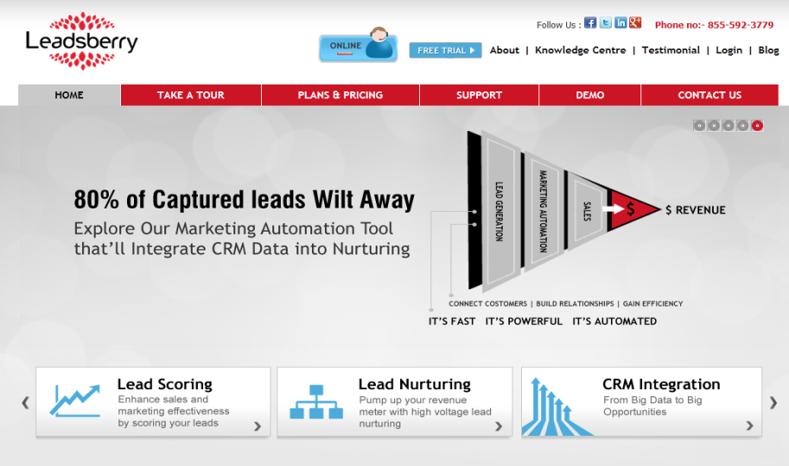
Client: Leads berry
Project Overview
A single platform to create and manage your entire lead nurturing campaigns
Fast and easy web-based access
Easy customization options
Entire process automated
Integrated Sales Intelligence
Project Duration
1 year
Project Completed Date
March 2013

Slide 15
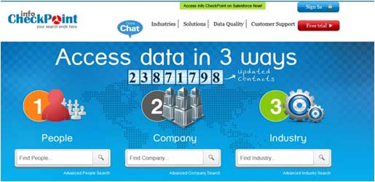
Client: Info checkpoint
Project Overview
Customized subscription model that suits to every pocket users can have unlimited access to browse 23 Million database
High Quality Data: With in-depth profile information, and verified records updated every 90 days
Varied Data Source: It differs from the data given by B2B Magazine Subscribers, Trade Show Card Collectors, Trade Show Organizers or Event Organizers
No Barrier Open Directory: Offers accurate information of 1 employee organization to fortune 500 companies
Project Duration
7 Months
Project Completed Date
Jan 2013

Slide 16
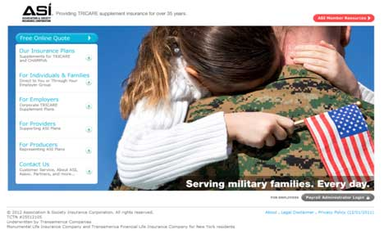
Client: ASI Insurance Corporation
Project Overview
This customer portal will provide information to various users pertinent to their relationship to ASI and provides them access to:
View claims
View billing transactions
View coverage and other account information
Request changes via a secured messaging function
Access policy specific forms and documents
With all Security Standards
Project Duration
8 Months
Project Completed Date
Dec 2013
Client Rating: 4.9/5

Slide 17












Other Client projects

Slide 18
Thank You !!
A Champions Group Company
www.strategicservices.com

